Slide 1

Movie Recommendation System

Slide 2
Agenda
Introduction
Recommendation Systems
Literature Review
Content based filtering
Collaborative filtering
Data transformations performed
EDA/Data Description
Content based model implementation +results
Collaborative model implementation + results
Findings
Recommendations for Business

Slide 3
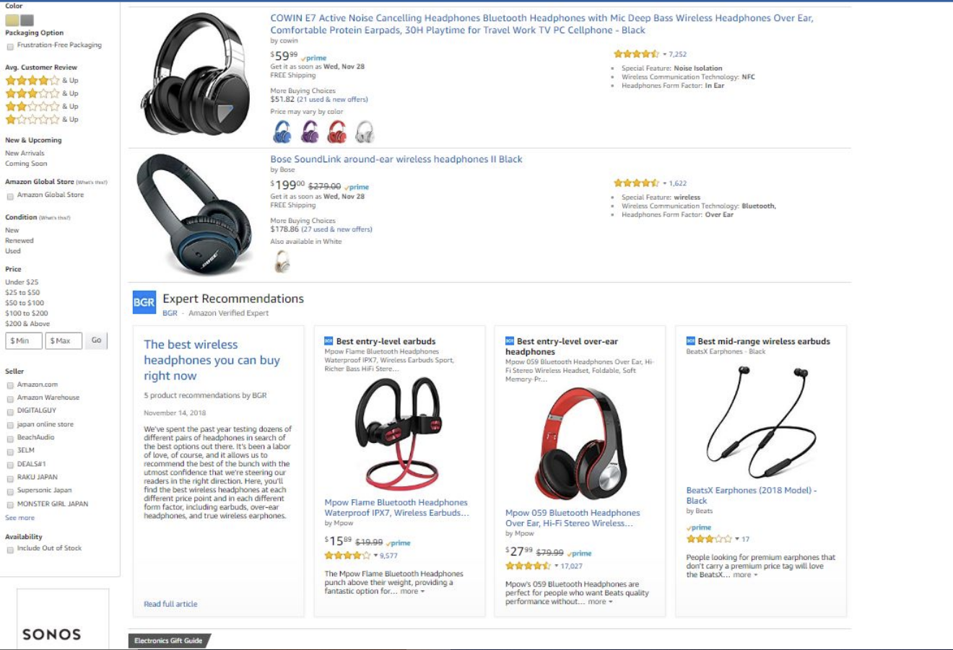
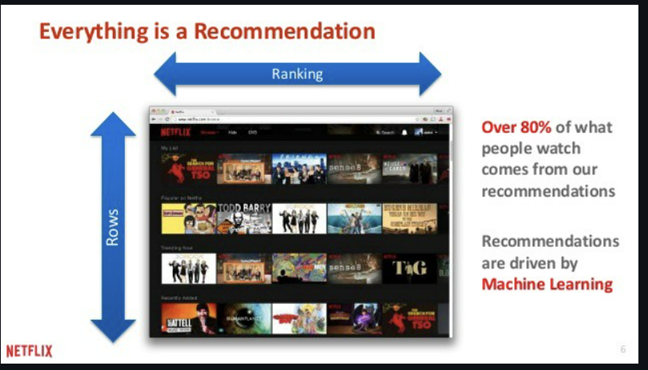
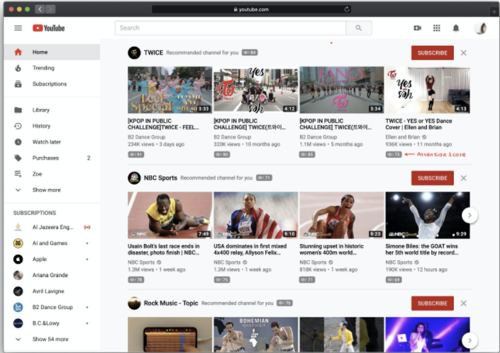
Introduction
Most internet products we use today are powered by recommender systems.

Slide 4
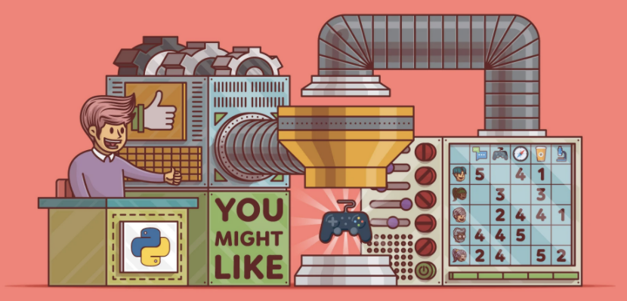
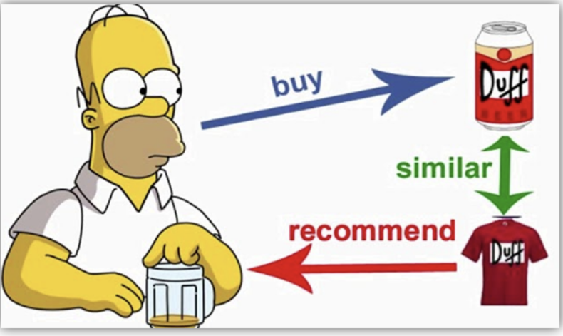
Recommendation Systems
A recommender system is a subclass of information filtering system that seeks to predict the “rating” or “preference” a user would give to an item.
Recommender systems are utilized in a variety of areas including movies,music,news,social,tags,and products in general.

Slide 5
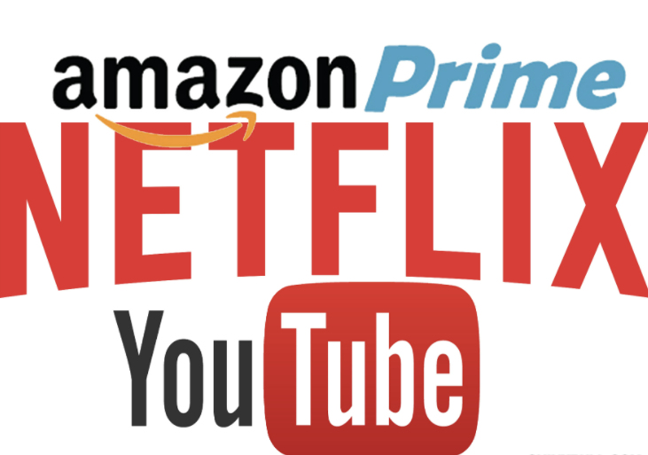
Literature Review
YouTube,Netflix,Amazon,Pinterest,and long list of other internet products all rely on recommender systems to filter millions of contents and make personalized recommendations to their users.
First implementation-1979-grundy
Netflix uses collaborative filtering method–2006
Netflix uses what we see from those profiles is the data-what people watch,what they watch after,what they watch before,what they watched a year ago,what they have watched recently and what time of day
Youtube tries to predict what a user would like to see next based on what they usually like to watch,based on their own preferences and interests.-2010
Amazon system uses a item based collaborative filtering which gives recommendations based on items that the user has purchased or has rated, which is then priced with similar items.-late 1990s

Slide 6
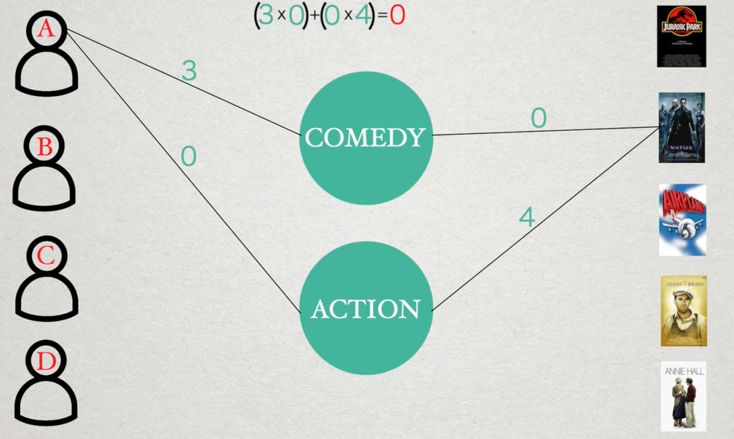
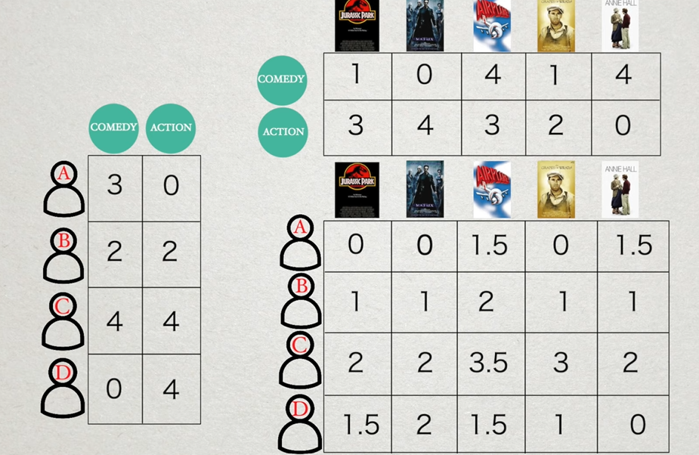
Content Based Filtering
Based on similarity of movies, basically, if you liked the movie “The Dark Knight”, you would probably like “Joker”.
Approach 1:
TF IDF concept, then it uses the most similar movies to a user’s already-rated movies to generate a list of recommendations.
Vector space is created. Cosine similarity for similarity.
Approach 2:
User Profile is created based on the data given by the user and suggestions are made on basis of that.
User provides more inputs, the engine becomes more and more accurate.
Advantages:
No need for data on other users
Able to recommend to users with unique tastes
Able to recommend new and unpopular items
Can provide explanations of recommended items by listing content-features that caused an item to be recommended.
Disadvantages:
Unable to exploit quality judgments of other users.
Overly simplistic and not very accurate - obviously there are so many more features rather than just genre

Slide 7
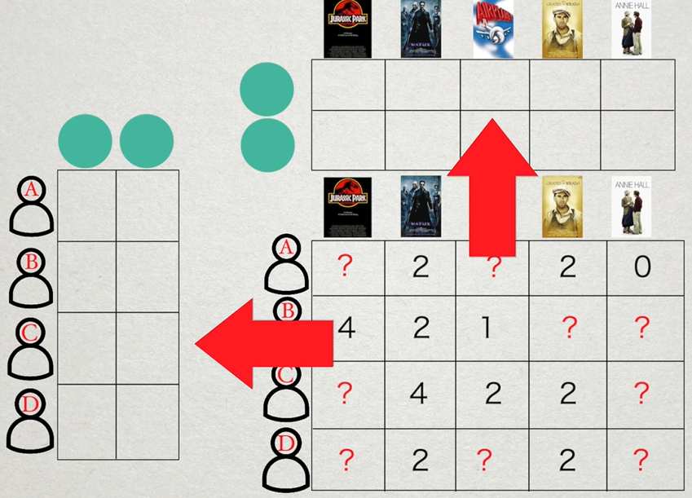
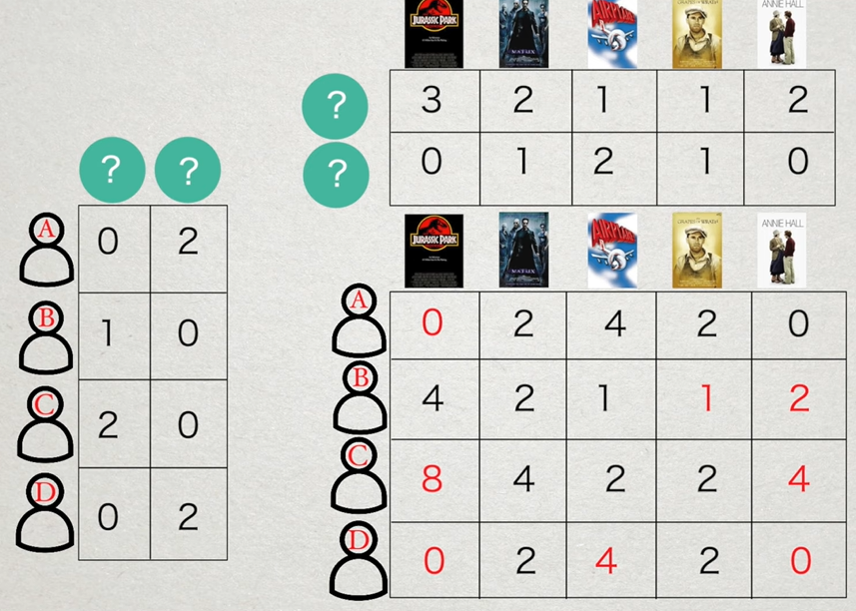
Collaborative Filtering
Better approach as it uses similarities between users to provide recommendations. Recommendation of movies to user A will be based on the interests of a similar user B.
Advantages:
No need to hand-engineer features
Latent features are generated which are average or weighted sum of the patterns in the data - not based on human designed feature
Accurate predictions
Latent features
Disadvantages:
There needs to be enough other users already in the system to find a match.
Cannot recommend an item that has not been previously rated
Popularity Bias: Tends to recommend popular items and cannot recommend items to someone with unique tastes.

Slide 8
Data Description
For movie recommendation system, two datasets has been used to broaden the scope of the analysis and get more insightful results
The two datasets have been combined with common variable Imdbid.
Dataset 1 Source : (For Ratings)
https://grouplens.org/datasets/movielens/1m/
Dataset 2 Source : (For additional movie metadata)
https://www.kaggle.com/code//movie-recommender-systems/dataselect=movies_metadata.csv

Slide 9
Dataset 1 Description
The dataset contains 1,000,209 anonymous ratings of approximately 3,900 movies made by 6,040 users. Each user has rated at least 20 movies. The data is segregated into 2 files.
Movies MovieID, Title, and Genres
Ratings UserID, MovieID, Rating, Timestamp

Slide 10
Dataset 2 Description
The dataset consists of 26,000,000 ratings applied to 45,000 movies by 270,000 users. The data is segregated into 2 files.
Link movieId, imdbId, tmdbId
movies_metadata adult, belongs_to_collection, budget, genres, homepage, id, imdb_id original_language, original_title,overview, popularity, poster_path, production_companies, production_countries, release_date, revenue, runtime, spoken_languages, status, tagline, title, video, vote_average, vote_count
From the movies_metadata, we have considered columns original_title, imdb_id, overview, tagline, vote_count and vote_average for the analysis

Slide 11
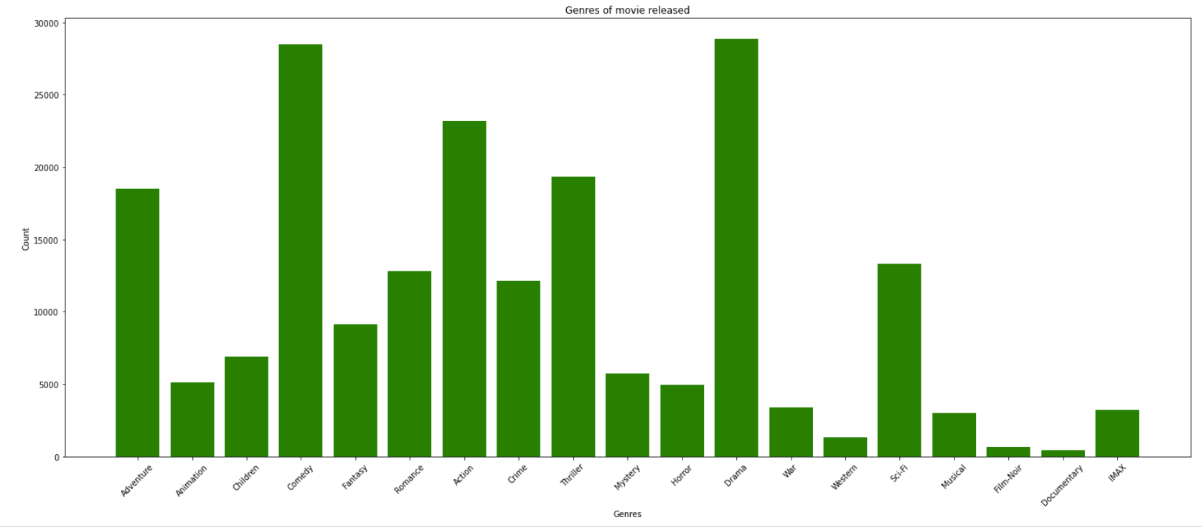
Exploratory Data Analysis (EDA) for Dataset 1
Most Popular Genres released

Slide 12
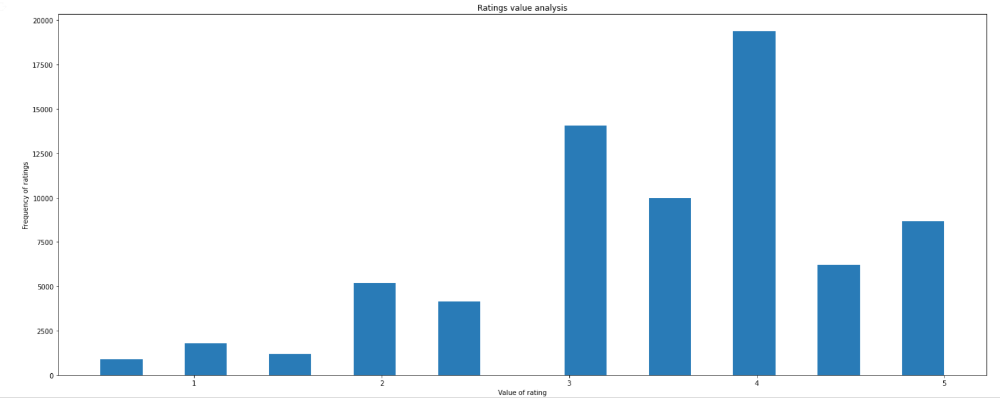
Frequency of the Ratings given by the User

Slide 13
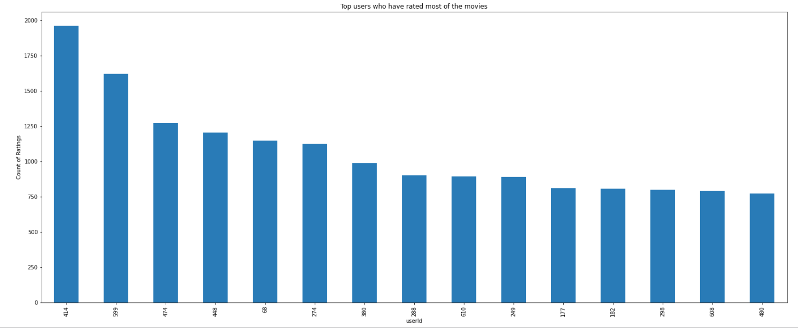
Top 15 users who have rated most of the movies

Slide 14
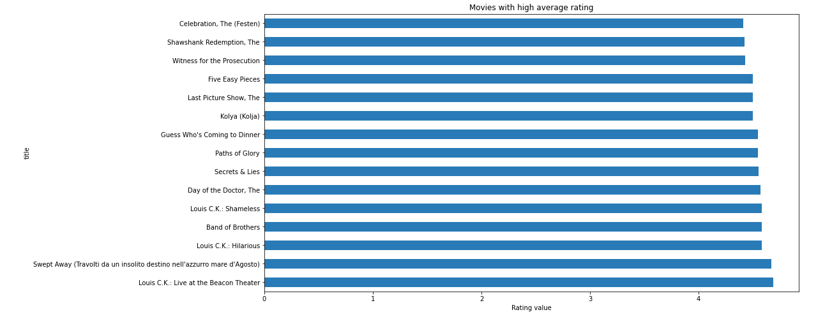
Movies with high average rating

Slide 15
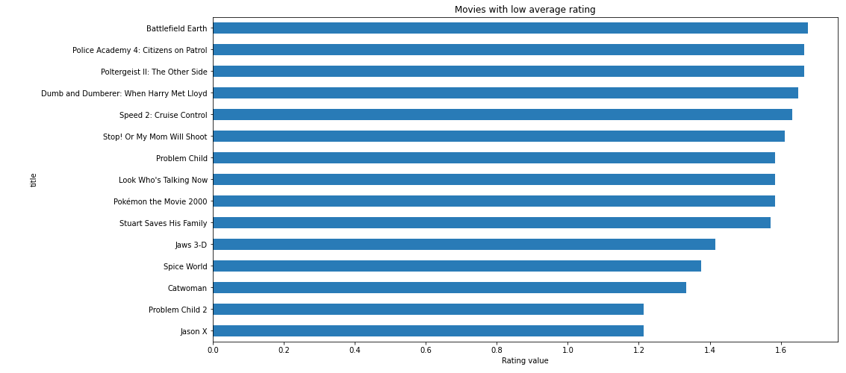
Movies with low average rating

Slide 16
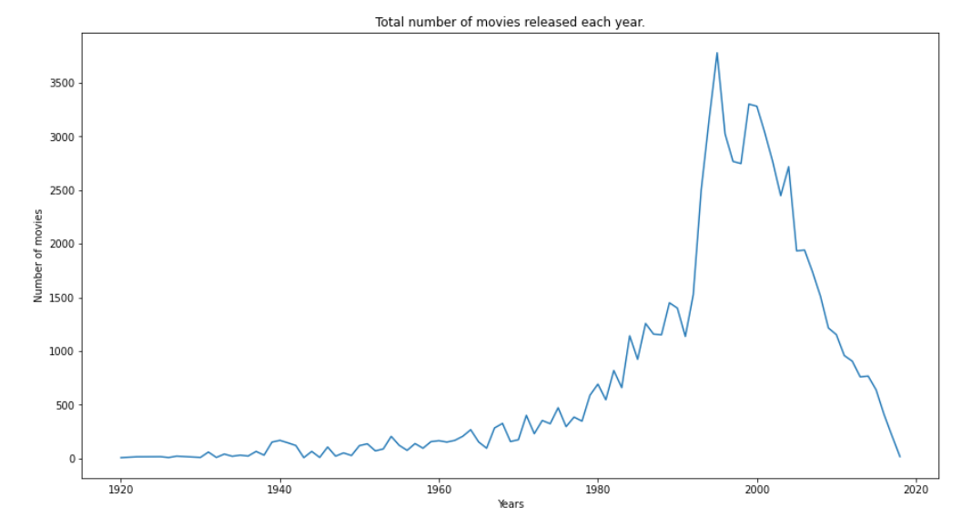
Total number of movies produced each year

Slide 17
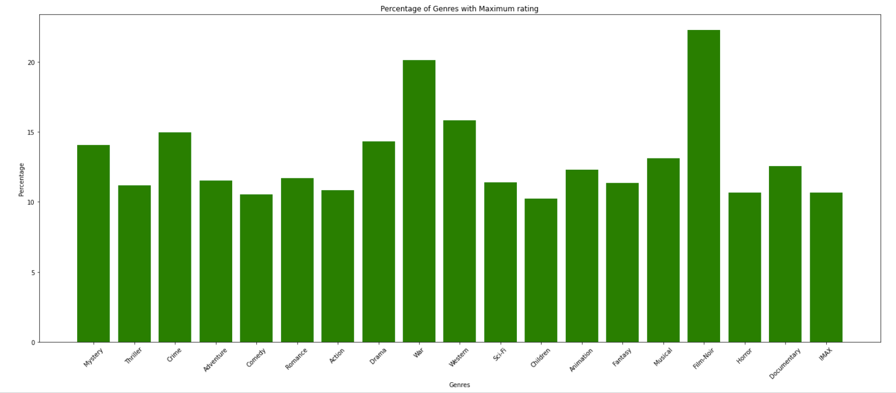
Percentage of Genres with maximum rating 5

Slide 18
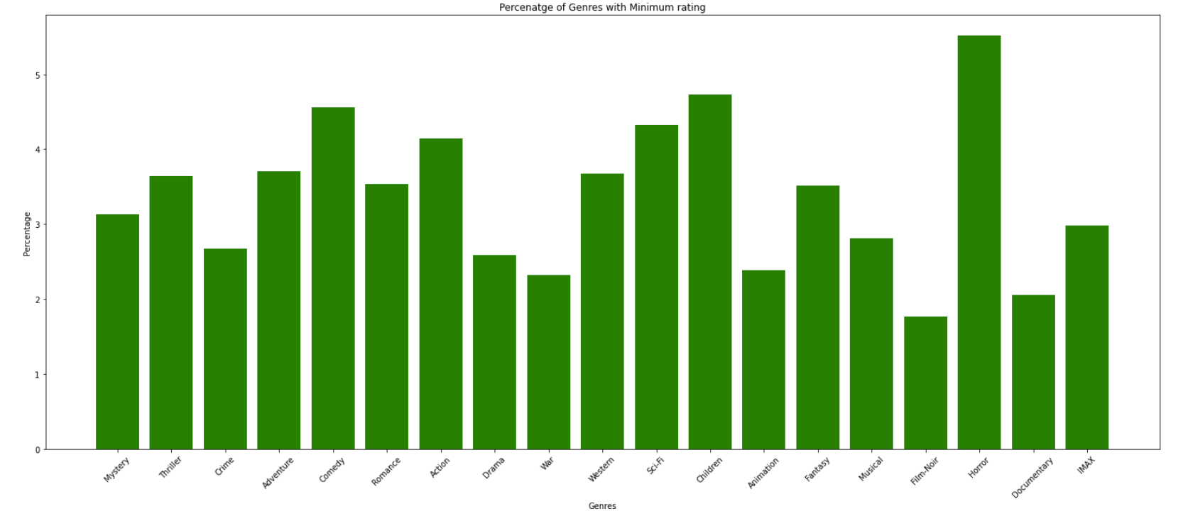
Percentage of Genres with minimum rating (less than and equal to 1)

Slide 19
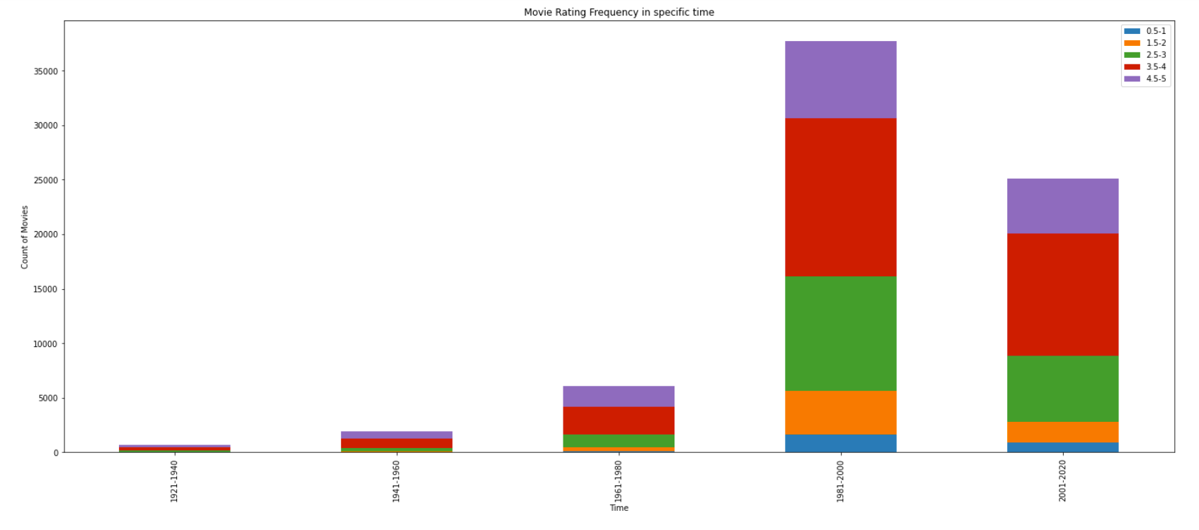
Rating frequency in specific time period

Slide 20
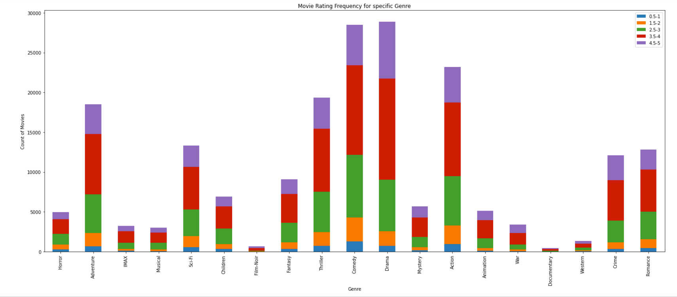
Rating frequency of Genres

Slide 21
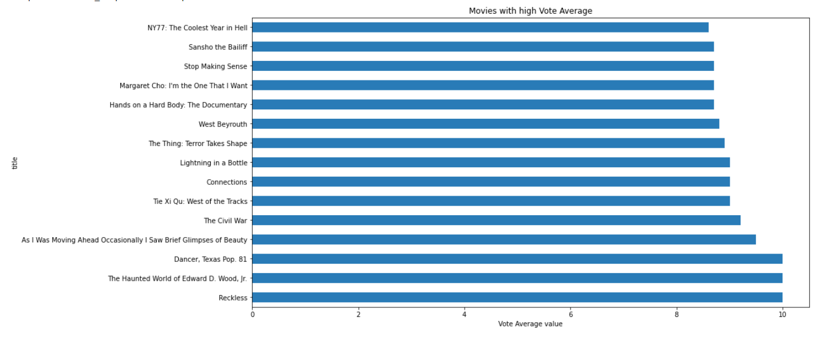
Exploratory Data Analysis (EDA) for Dataset 2
Movies with High Vote Average

Slide 22
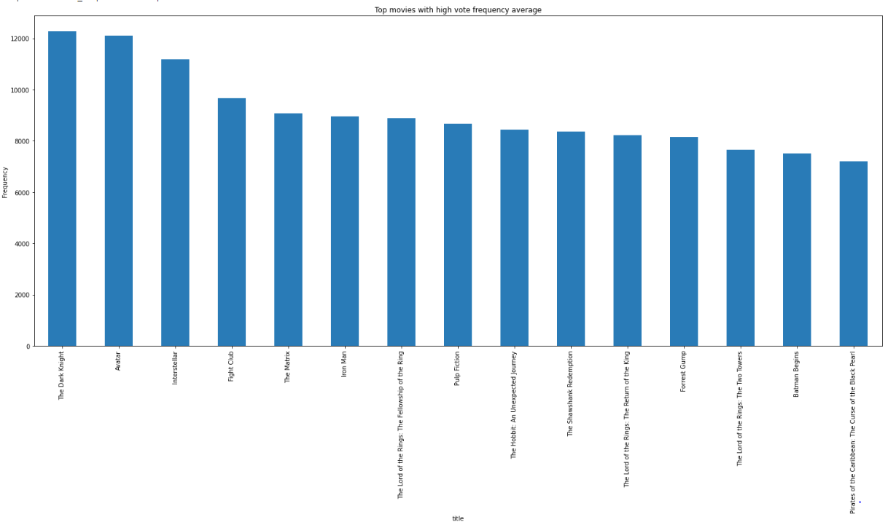
Top 15 Movies with high vote frequency average

Slide 23
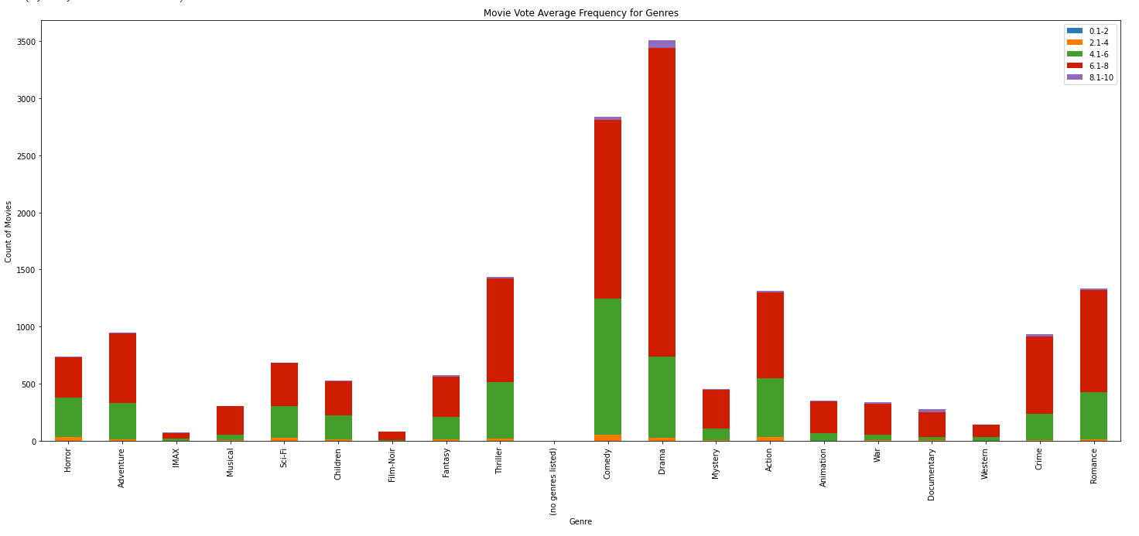
Vote average frequency for Genres

Slide 24
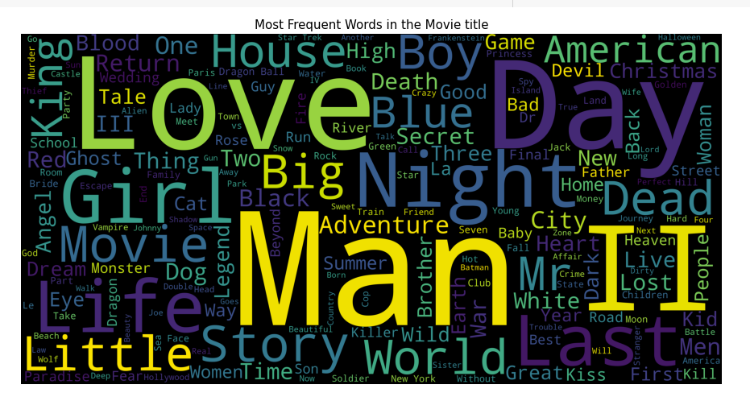
Word cloud for Movie title

Slide 25
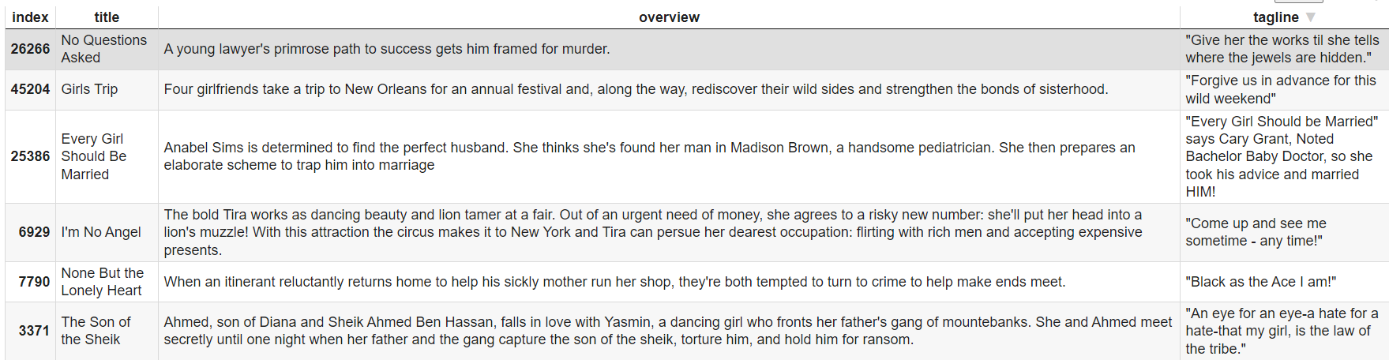
Model Implementation : Content based Filtering
Goal : To recommend movies that are the most similar to a movie liked by a user, by computing similarity between movies, using Movie Metadata. (Hence, Content Based Filtering). We implement this using a TF-IDF Vectorizer and Cosine Similarity Measure.
Notes:
From our EDA, we saw the best Romance, Action, Horror and other genre movies that can be recommended to users. But this is not taking into consideration the user’s personal preferences and taste. In order to incorporate the same, we built a content recommendation filtering system.
Goal : To recommend movies that are the most similar to a movie liked by a user, by computing similarity between movies, using Movie Metadata. (Hence, Content Based Filtering)
We combine two datasets for our analysis, our original ‘movielens’ dataset and a new ‘movie_metadata’ dataset, which contains additional information like Movie descriptions and taglines.
We combine a movie’s title, overview and tagline to form a movie description which we then pass to our TF-IDF Vectorizer object.
The description passed for the movie ‘Toy Story’ looks like this :
We implement this using a TF-IDF Vectorizer and Cosine Similarity Measure.

Slide 26
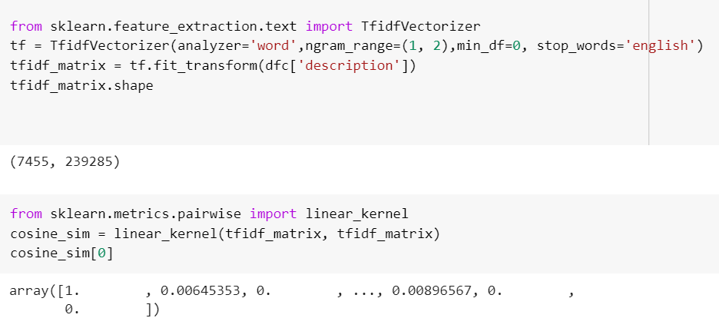
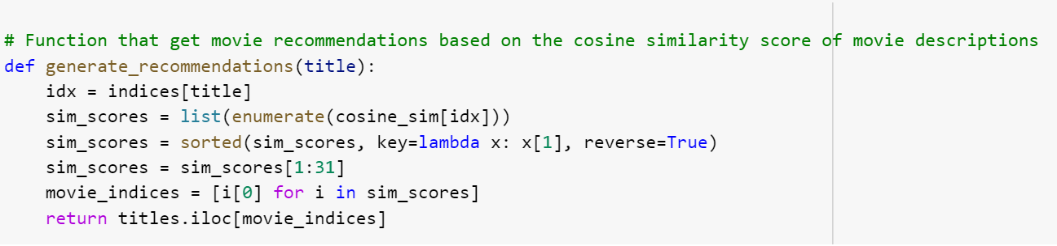
Model Implementation : Content based Filtering
Notes:
TF-IDF will first convert text into a meaningful numerical representation, which will help capture the importance of items by giving a higher weight to the less frequent items and vice-versa. It is then used to fit a machine learning algorithm for prediction.
We then define cosine similarity as our proximity measure and compute the cosine similarities between all tf-idf vectors/keywords to give us a cosine similarity score. Calculating the Dot Product of the TF-IDF vectors will directly give us the Cosine Similarity Score.We now have a pairwise cosine similarity matrix for all the movies in our dataset.
And then we wrote a function to return most similar movies based on similarity score.

Slide 27
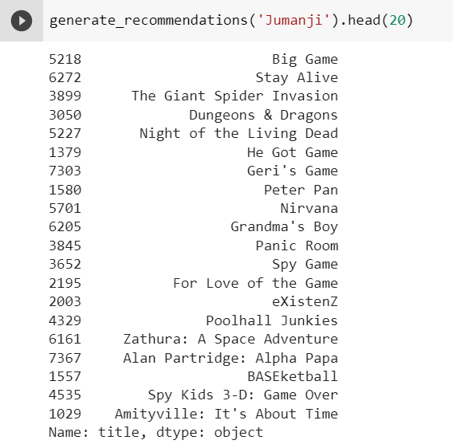
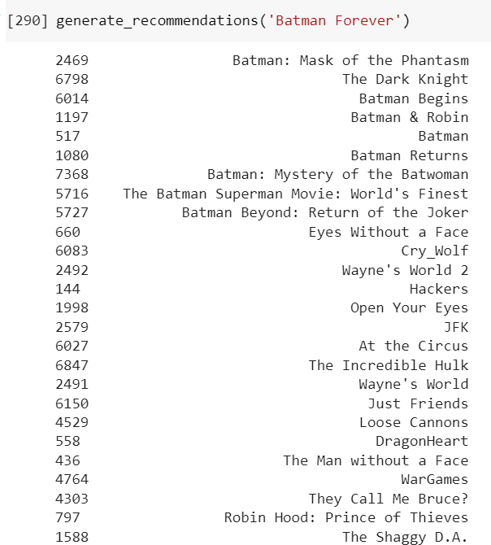
Model Implementation : Content based Filtering
Notes:
We can see that the model returns similar movies in the Batman franchise, but it is not taking into consideration movie ratings at all. For example, Wayne’s world and Batman and Robin are two such movies that have extremely low ratings and should not be recommended. Hence, we modify our system to include movies with good reviews.

Slide 28
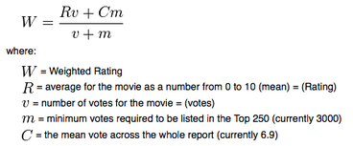
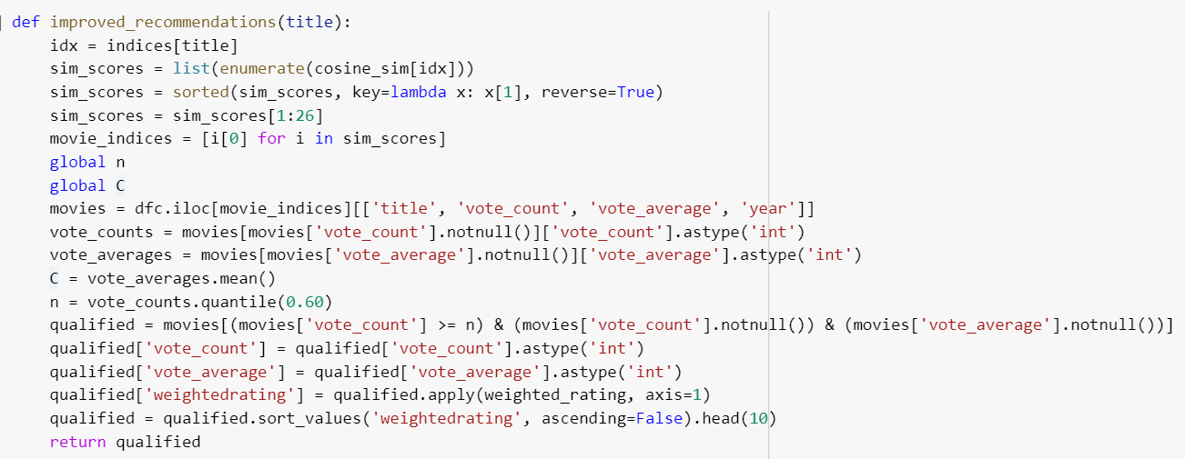
Model Implementation : Content based Filtering
IMDB's weighted rating formula to derive weighted rating.
To return movies with good critical response.
Notes:
We then derive the weighted rating of every movie using the above formula.
And then we accordingly, returned movies sorted in order of rating first i.e. keep popular movies with good critical response first and remove bad movies.

Slide 29
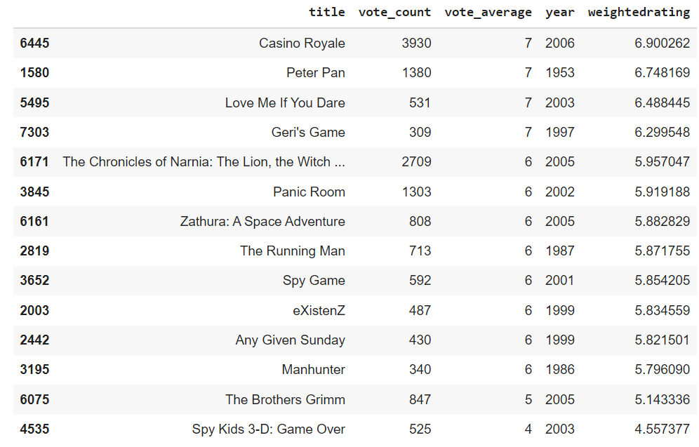
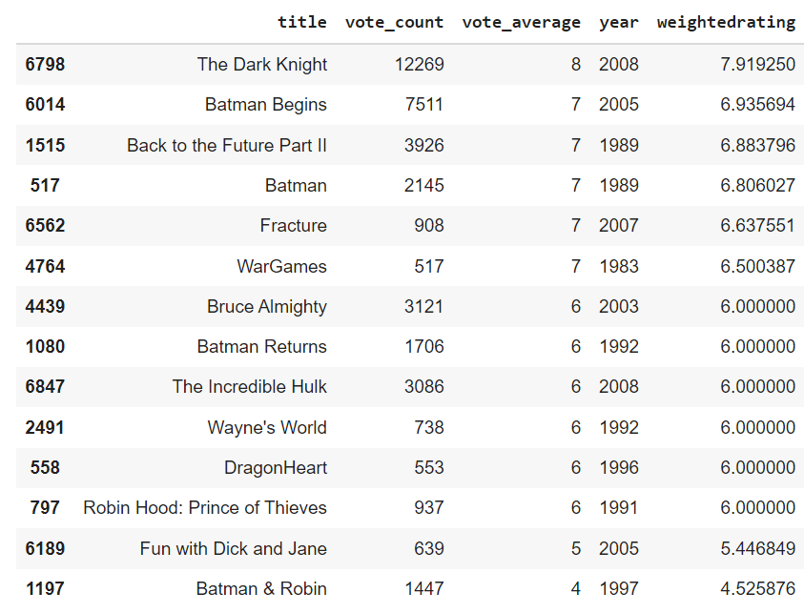
Model Implementation : Content based Filtering
Improved recommendations for ‘Jumanji’
Improved recommendations for ‘Batman Forever’
Notes:
//Unfortunately, Batman and Robin will not be removed from our list of recommended films. This is most likely due to its IMDB rating of 4.5, which is about average. It doesn't deserve a 4 when great films like The Dark Knight Rises only get close to an 8.

Slide 30
Model Implementation : Collaborative Filtering
Goal : The main idea behind this method is to use other users’ preferences and taste to recommend new items to a user. It's based on the idea that people who agree in their evaluation of certain items are likely to agree again in the future. “Similar people like similar things”. We use the Surprise library for our Collaborative Filtering analysis.
Baseline Model ( KNNBaseline model + No Hyperparameters)
SVD Model ( Matrix factorization Technique that uses gradient descent to create predictions for a users’ ratings, while minimizing the error between the predicted ratings and the actual ratings from our original utility matrix. )
KNN Basic Model
KNN Baseline Model ( KNNBaseline model + Tuned Hyperparameters)
For every model, we applied GridSearch as our optimization tool to identify the best parameters that reduce our RMSE.
We also ran 3-fold cross validation to verify the RMSE for test data and gain a more accurate approximation of how well a set of hyperparameters performs.
Notes:
Content filtering is great for new users. New users- content model. What about existing users who have preferences. Here we want to be able to predict their rating for a movie. Hence for this we use collaborative filtering.
You will probably like things ppl with similar viewing habits also like.
Baseline- These are the values we will look to improve by attempting different models and including hyperparameters in future models.
KNN Basic - The algorithm looks at the nearest neighbors to determine which movie to predict.

Slide 31
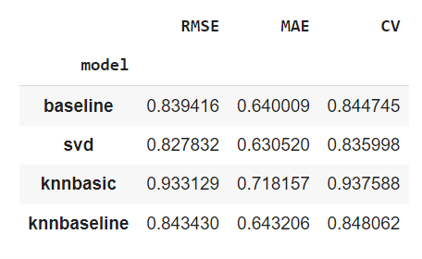
Model Comparison
Unfortunately, all of our models perform worse than the baseline, with the exception of the SVD model. SVD had an RMSE of 0.82, compared to the baseline of 0.83.
As a result, we will disregard the KNN models for the remainder of our analysis and will move forward with our SVD tuned model, as it performed the best in terms of RMSE, MAE and CV.
Therefore, we can conclude that on average, our SVD model estimates ratings with an error of approximately 0.8. Generally, with these models, we are trying to get a sense of what rating the user would rate a movie; and since these results are quite difficult to validate (we do not actually know if a user will enjoy a movie or not in reality), the estimation error of 0.80 is reasonably acceptable.
Notes:
Unfortunately, all of our models perform worse than the baseline, with the exception of the SVD model. SVD had an RMSE of 0.82, compared to the baseline of 0.83.
Additionally, SVD MAE score was 0.63 which is lower than the baseline result of 0.64. Lastly, when performing 3-fold cross validation, our SVD performs slightly better than the baseline with a result of 0.808, compared to the baseline result of 0.815.
As a result, we will disregard the KNN models for the remainder of our analysis and will move forward with our SVD tuned model, as it performed the best in terms of RMSE, MAE and CV.
Therefore, we can conclude that on average, our SVD model estimates ratings with an error of approximately 0.8. On a scale of 0-5, this 0.80 value is not too significant, as a rating of 3 compared to 3.8 is not a significant difference in context. Generally, with these models, we are trying to get a sense of what rating the user would rate a movie; and since these results are quite difficult to validate (we do not actually know if a user will enjoy a movie or not in reality), the estimation error of 0.80 is reasonably acceptable.

Slide 32
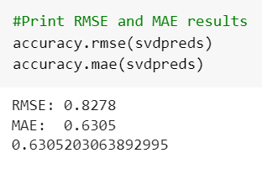
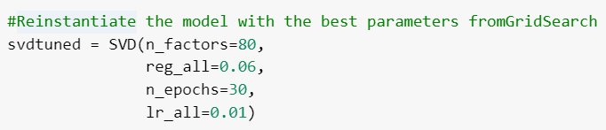
SVD Model
Hyperparameters tuned :
lr_all – The learning rate for all parameters. Default is 0.005.
n_factors – The number of factors. Default is 100.
n_epochs – The number of iterations of the SVD procedure. Default is 20.
reg_all – The regularization term for all parameters. Default is 0.02.

Slide 33
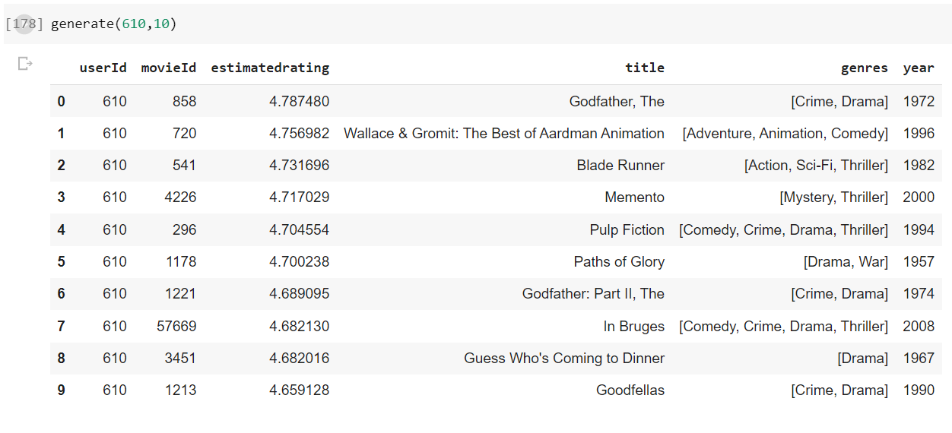
Model Implementation : Collaborative Filtering
We will then create a function that generates ratings for a user, using predictions from our final SVD model.
Movies recommended to User 610 :
Notes:
//Unfortunately, Batman and Robin will not be removed from our list of recommended films. This is most likely due to its IMDB rating of 4.5, which is about average. It doesn't deserve a 4 when great films like The Dark Knight Rises only get close to an 8.

Slide 34
Recommendations:
The goal of a recommender system is to keep customers engaged with recommendations through which they retain existing customers and entice new customers with their AI powered recommendations.
Webflix should make selective investments in movies/genres based on the customer ratings & popularity.
As War and Film noir has highest rating, Webflix should concentrate on investing into the best films in other genres which brings the best ratings from the users.
Improving customer engagement through personalized recommendations. Based on vote average frequency, comedy and drama are highly voted by the users.

Slide 35
Conclusion and Future Work
Overall, our Collaborative filtering model does a decent job of estimating user's ratings with an error of 0.8, and our content based filtering model successfully recommends movies to new users.
Disadvantage : Collaborative filtering Models do not address the 'cold start problem', i.e. If you do not have ratings from the users, how will you predict more ratings?
Solution : Create a hybrid model that incorporates both content and collaborative models, where the Content based model is used for new users and the Collaborative filtering Model used when enough data on user’s preferences has been gathered.
Future work :
Incorporate other features like ‘Genres’ and ‘Year’ in our content based model.
Incorporate other features like ‘Genres’, ‘Cast’, and ‘Crew’ in our collaborative model.
Notes:
It is difficult to validate the results of our model, but it would be interesting to see if users do end up watching movies recommended to them and if so how they are rated.

Slide 36
Thanks!

